Slide 1
PROFESSIONAL ETHICS (HUT 200)
Module V
Global Ethical Issues

Slide 2
Syllabus
Multinational Corporations - Environmental Ethics - Business Ethics - Computer Ethics -Role in Technological Development - Engineers as Managers - Consulting Engineers- Engineers as Expert witnesses and advisors -Moral leadership.

Slide 3
MULTINATIONAL CORPORATIONS (MNCs)
Organisations who have established business in more than one country, are called multinational corporation.
A Multinational Company is one which is incorporated in one country(called the home country) and which carries business in other countries(called the host countries) in addition to the home country.
A Multinational corporation is known by several names such as global enterprise, international enterprise, world enterprise etc.
Eg: Cadbury, Coca-Cola Corporation, Unilever etc.

Slide 4
Features of Multinational Corporations (MNCs):
Huge Assets and Turnover
International Operations through a network of branches.
Unity of Control
Advanced and sophisticated technology
Professional Management
Aggressive Advertising and Marketing
Better Quality of Products

Slide 5
Advantages of MNCs from viewpoint of host country
Employment generation
Automatic Inflow of Foreign Capital
Proper Use of Idle Resources
Technical Development
Managerial Development
End of Local Monopolies
Improvement in Standard of Living
Promotion of International brotherhood and culture

Slide 6
Limitations of MNCs from viewpoint of host country
Danger for Domestic industries
Repatriation of Profits
No Benefit to poor people
Danger to independence
Disregard to the national interests of the host country
Careless exploitation of natural resources
Selfish promotion

Slide 7
Advantages of MNCs from viewpoint of home country
MNC’s usually get raw-materials and labour supplies from host countries at lower prices.
MNC’s can widen their market for goods by selling in host countries, and increase their profits. They usually have good earnings by way of dividends earned from operations in host countries.
Through operating in many countries and providing quality services, MNCs add to their international goodwill on which they can capitalize in the long run.

Slide 8
Limitations of MNCs from viewpoint of home country
There maybe loss of employment in the home country, due to spreading manufacturing and marketing operations in other countries.
MNCs face several problems of managing cultural diversity.

Slide 9
ENVIRONMENTAL ETHICS
Environmental ethics deal with issues related to the rights of individuals in concern with the environment.
The environment ethics include
Study of moral issues concerning the environment
moral perspectives, beliefs, or attitudes concerning those issues.
It has become important that engineers design eco-friendly tools, machines, sustainable products, processes and projects.
These are essential to
Ensure protection (safety) of environment
Prevent the degradation of environment, and
Slow down the exploitation of the natural resources, so that the future generation can survive.

Slide 10
Two world views on Environmental ethics
Anthropocentric Worldview / Human-centered environmental ethics
Eco-centric Worldview / Nature-centered ethics

Slide 11
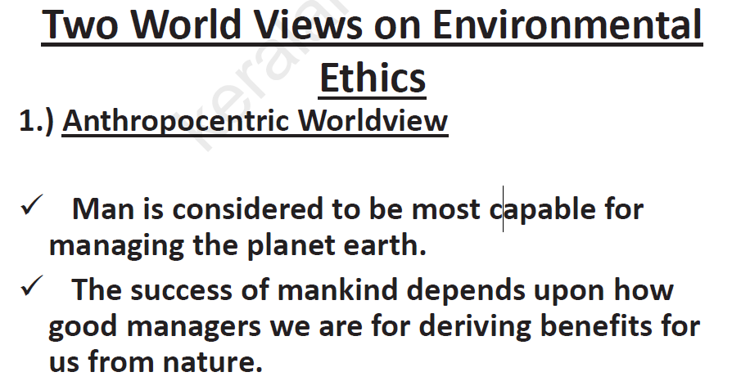

Slide 12
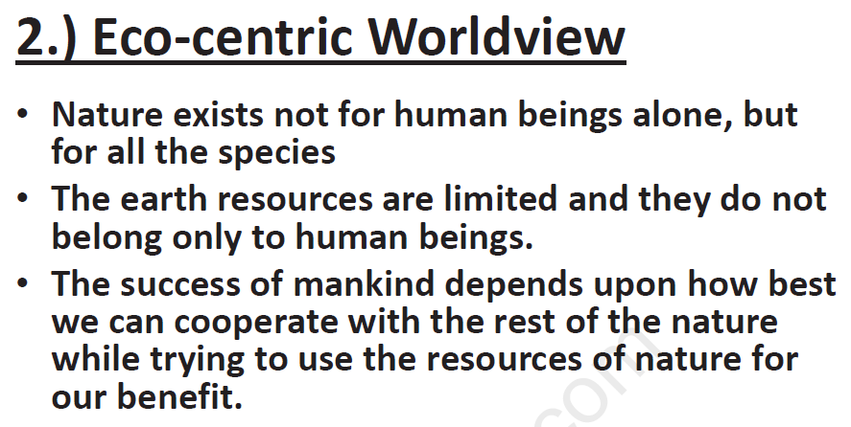

Slide 13
Engineers as experimenters have duties towards environmental ethics namely:
Environmental impact assessment : Study of how the industry and technology affect the environment. Eg: in terms of wastage, pollution of land, air, water etc.
Establish standards : Study and fix the tolerable and actual pollution levels.
Counter measures : Study what protective or eliminating measures are available for immediate implementation.
Environmental awareness : Study on how to educate the people on environmental practices, issues and possible remedies.

Slide 14
Disasters
Plastic Waste Disposal
e-Waste Disposal
Industrial Waste Disposal
Depletion of Ozone Layer
Global Warming
Acid Rain

Slide 15
BUSINESS ETHICS
The system of moral principles and rules of the conduct applied to business.
Defined as the systematic study of ethical matters pertaining to the business, industry or related activities, institutions and beliefs.

Slide 16
Factors Considered
A business should aim to have fair dealing with everyone dealing with it.
Ethics should be fixed for everyone working in the organisation at any level and their implementation should be linked with reward- punishment system.
Any violation of ethics should be detected at the earliest and remedial measures taken immediately.
Business ethics should be based on broad guidelines of what should be done and what should be avoided.
The ethics should be based on the perception of what is right.

Slide 17
Sources of Business Ethic
Religion, Culture and Law
Importance of Business Ethics
Corresponds to Basic Human Needs
Credibility in the Public
Credibility with the Employees
Better Decision Making
Profitability
Protection of Society

Slide 18
COMPUTER ETHICS
Computer ethics is defined as
(a) study and analysis of nature and social impact of computer technology,
(b) formulation and justification of policies, for ethical use of computers.
Computer ethics is related to all the computer professionals such as programmers, analysts, operators, designers etc along with the users.

Slide 19
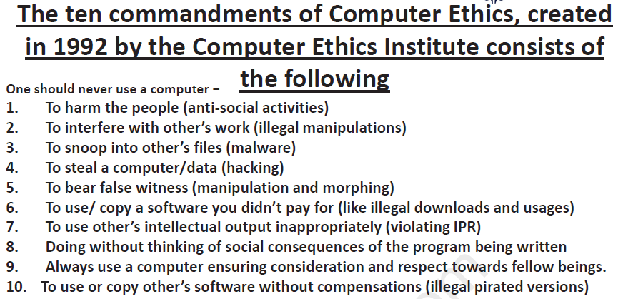

Slide 20
Types of Issues
Computer as the Instrument of Unethical Acts
Usage of computer replaces the job positions
Breaking privacy: Information or data of individuals accessed or erased or ownership changed
Defraud a bank or a client: By accessing and withdrawing money from others bank account.
Computer as the Object of Unethical Act: Hacking, Spreading virus, Health hazard
Problems Related to the Autonomous Nature of Computer: Security risk, Loss of human lives

Slide 21
Computers in Workplace
Ethical problems initiated by computers in workplace are:
Elimination of routine and manual jobs
Health and safety
Computer failure
Property Issues
Computers have been used to extort money through anonymous telephone calls.
Computers are used to cheat and steal by current as well as previous employees.
Cheating of and stealing from the customers and clients.
Violation of contracts on computer sales and services.
Conspiracy as a group, especially with the internet, to defraud the gullible, stealing the identity and to forge documents.
Violation of property rights

Slide 22
ENGINEERS AS MANAGERS
Characteristics of engineers as managers are:
Promote an ethical climate, through framing organization policies, responsibilities and by personal attitudes and obligations.
Resolving conflicts, by evolving priority, developing mutual understanding, generating various alternative solutions to problems.
Social responsibility to stakeholders, customers and employers

Slide 23
Managing Conflicts
The conflicts in case of project managers arise in the following manners:
Conflicts based on schedules
Conflicts arising out of fixing the priority to different projects or departments
Conflict based on the availability of personnel
Conflict over technical, economic, and time factors
Conflict arising in administration
Conflicts of personality, human psychology and ego problems
Conflict over expenditure and its deviations

Slide 24
Solving conflicts
People: views of all concerned should be obtained.
Interests: Focus must be only on the ethical attitudes or motives and not on the positions..
Options: Generate various options as solutions.
Evaluation: based on some specified objectives such as efficiency, quality, and customer satisfaction

Slide 25
CONSULTING ENGINEERS
Consulting engineers differ from the salaried engineers of an organisation.
The consulting engineers work in private and are paid per advice they offer or for the service given.
Consultants are individuals who typically work for themselves but may also be associated with a consulting firm.

Slide 26
Ethical responsibilities of consulting engineers
Advertising
They are directly responsible for advertising their services
Deceptive advertisings are prohibited (white lies, Half-truth, exaggerated claims, making false suggestions, through vague wordings or slogans.)
Competitive Bidding
Offer a price and get something in return for the service offered.
Contingency Fee
Fee or commission paid to the consultant, when one is successful in saving the expenses for the client.
Safety and Client’s Needs

Slide 27
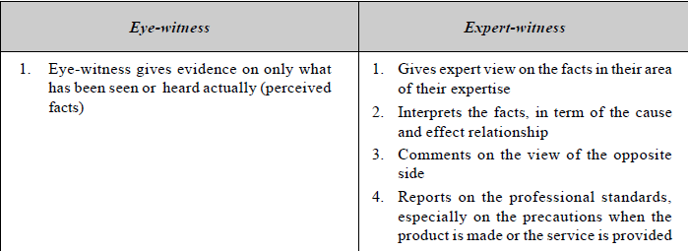
ENGINEERS AS EXPERT WITNESS
Required to provide expert opinion and views in many legal cases of the past events.
They are required to explain the causes of accidents, malfunctions and other technological behavior of structures, machines and instruments.

Slide 28
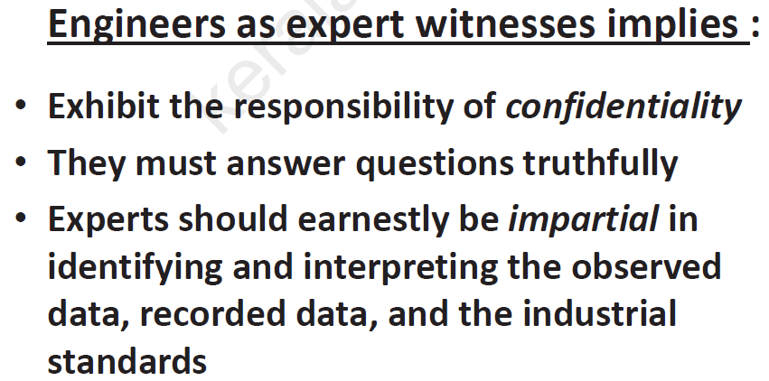

Slide 29
Expert-witnesses, are likely to abuse their positions in the following manners:
Hired Guns
Mostly lawyers hire engineers to serve the interest of their clients. Lawyers are permitted and required to project the case in a way favorable to their clients. But the engineers have obligations to thoroughly examine the events and demonstrate their professional integrity to testify only the truth in the court.
Money Bias
Consultants may be influenced or prejudiced for monitory considerations, gain reputation and make a fortune.
Ego Bias
The assumption that the own side is innocent and the other side is guilty, is responsible for this behavior
Sympathy Bias
Sympathy for the victim on the opposite side may upset the testimony

Slide 30
ENGINEERS AS ADVISORS IN PLANNING AND POLICY MAKING
As advisor, give their view on the future such as in planning, policy-making, which involves the technology.
Issues and requirements
Objectivity: study the cost and benefits of all possible alternative means in objective manner
Study All Aspects: economic viability (effectiveness), technical feasibility (efficiency), operational feasibility (skills) and social acceptability
Values
Technical Complexity
National Security

Slide 31
Shared understanding can be effected by the following roles or models:
Hired Gun
The prime obligation is shown to the clients. The data and facts favorable to the clients are highlighted, and unfavorable aspects are hidden or treated as insignificant.
The minimal level of interest is shown for public welfare
Value-neutral Analysts
This assumes an impartial engineer.
They exhibit conscientious decisions, impartiality i.e., without bias, fear or favor, and absence of advocacy.
Value-guided Advocates
The consulting engineers remain honest (frank in stating all the relevant facts and truthful in interpretation of the facts) and autonomous (independent) in judgement and show paramount importance to the public (as different from the hired guns).

Slide 32
MORAL LEADERSHIP
Moral leaders are the individuals who adopt reasonable means to motivate the groups to achieve morally desirable goals.
Moral Leadership is required for engineers, for the reasons listed as follows:
To build morally creative leaders –
The leadership shall direct and motivate the group to move through morally desirable ways.
They lead by thinking ahead in time, and morally creative towards new applications, extension and putting values into practice.
Participation in Professional Societies
Voluntary Service
Leadership in Communities
Motivate the group

Slide 33
University Questions
Describe the various requirements for engineers who act as advisors. (3)
List out the importance of Business Ethics. (3)
What is environmental ethics?(3)
Justify the need of moral leadership in today’s business environment?(3)
What are the fundamental duties to be kept in mind while engineers fulfill their professional duties? (3)
Describe the two world views on Environmental Ethics.(8)
Explain the different types of issues in Computer Ethics.(6)
Explain the features, advantages and limitations of MNCs.(14)
Discuss in detail about the moral and ethical issues involved in the use of computers and internet with examples.(14)
Discuss the following in detail: (14 marks)
a) Engineers as consultants
b) Engineers as expert witnesses

Slide 34
1. What is Environmental Ethics?
2. What is CSR?
3. What is meant by globalization?
4. What is meant by moral leadership?
PART B
1. Discuss the role and importance of Ethics in Engineering?
2. Explain the significance of environmental ethics for an engineer with suitable example
3. Discuss the role of ethical engineers in weapon development with suitable examples
4. Justify engineers as expert witnesses and advisors with suitable examples
5. Explain the different types of issues in computer ethics
6. What are the various conflict situations faced by a project manager managing a work site
7. Explain human centered ethics with nature centered Ethics .
8. Discuss the merits and demerits of MNC’s
9. What is the role of Computers in Technological development? Recall the ten commandments in Computer ethics? (7)
(b) What do you understand by moral leadership? Explain (7)
10 (a) What are the salient features of MNC? List the merits and demerits of MNCS in the host country? (7)
(b) Point out the responsibilities of consulting engineers? (7)

